Slide 1
Introduction to Discrete Event Simulation Session 1
Arnold Buss
MOVES Institute
Naval Postgraduate School
Monterey, CA 93943

Slide 2
Session 1 Overview
Course Objectives
Course Materials
Purpose of Simulation Models
Modeling Time
States and Events
State Trajectories
Event List
Structure of DES Model
Example

Slide 3
Course Overview
Day 1
Introduction to DES & Event Graphs
Day 2
Event Graph Modeling
Using EventGraphGUI Program
Day 3
More Event Graph Modeling
Dealing with Output
Day 4
Output Analysis

Slide 4
Course Objectives
Understand Structure of Discrete Event Simulation Models
Explain the difference between time step and next event
Understand the structure of an Event Graph model
Formulate medium-size Event Graph model
Execute a pre-built Event Graph Model
Perform basic output analysis on a pre-built Event Graph model

Slide 5
Course Materials
Powerpoint Slides
Introduction to Discrete Event Simulation (Handout)
Problems and Exercises (Handouts)
EventGraphGUI program
Java version 8 or above (required to run EventGraphGUI)

Slide 6
Simulation Modeling Overview
Purpose of simulation model
Training
Analysis
Modeling Time in Simulation
Time Step
Next Event
Hybrid
“All models are wrong”

Slide 7
Types of Models
Analytic
Solution by equation
Many stochastic models (e.g., Markov chain)
Algorithmic
Solution by algorithm
Optimization models (e.g., linear programming)
Simulation
“Solution” not easily forthcoming
Execute the simulation (e.g., DRPSim)

Slide 8
Discrete Event Simulation (DES)
States
Events
Event List
Structure of DES Model
DES Examples

Slide 9
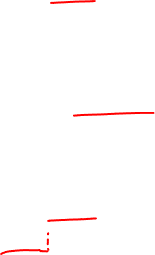
Discrete Event Simulation
Define model by collection of states
State trajectories piecewise constant
State transitions instantaneous in simulated time (“Jumps”)
Jumps = “Events”

Slide 10

States
Variables that describe snapshot of system
State trajectory
Graph of state over time
DES States change instantaneously
State trajectories must be piecewise constant

Slide 11
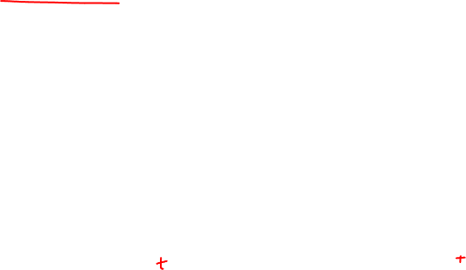
Inadmissible State Trajectories

Slide 12
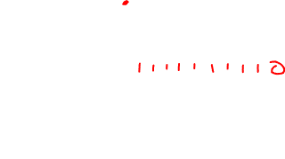
Admissible State Trajectory
Events

Slide 13
Events
Event = “Interesting” occurrence
Between events, nothing happens in model
Events may schedule other events
Order of events' occurrence not necessarily same as order scheduled

Slide 14
Event List
Keeps pending events in list
Inserts events in order when scheduled
Advances time:
Advance time to next scheduled event
Remove event and process
Repeat while Event List not empty

Slide 15
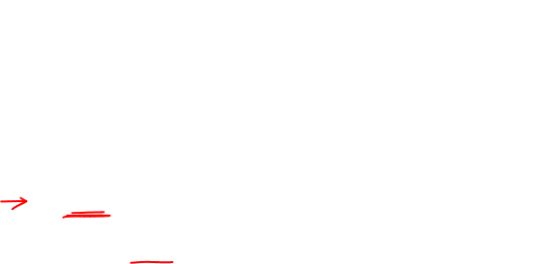
Starting Up
Initially Event List is empty
Need at least one initial event
“Run” event always scheduled to occur at time 0.0
Like “main” method – starting point for Event List
Processed like any other Event

Slide 16
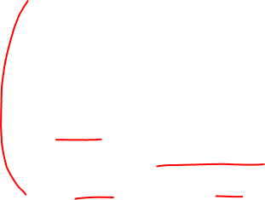
Structure of DES Model
Parameters
Don’t “change” during a single run
State Variables
Typically do change during a single run
Events
When state transitions occur
Scheduling Relationships
Events that schedule other events

Slide 17
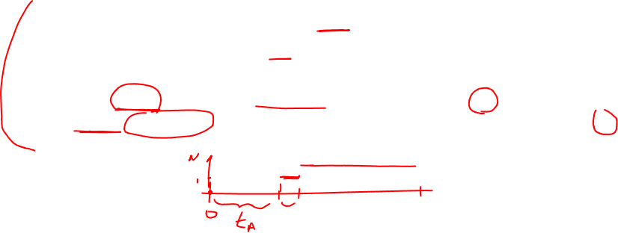
Example: Arrival Process
Parameter: Interarrival times {t_{A}}
State: Number Arrivals (N)
Events:
Run: N = 0; Schedule first Arrival with delay of first t_{A} value
Arrival: N = N + 1; Schedule next arrival with delay of subsequent t_{A} values

Slide 18
Possible State Trajectory

